Slide 1
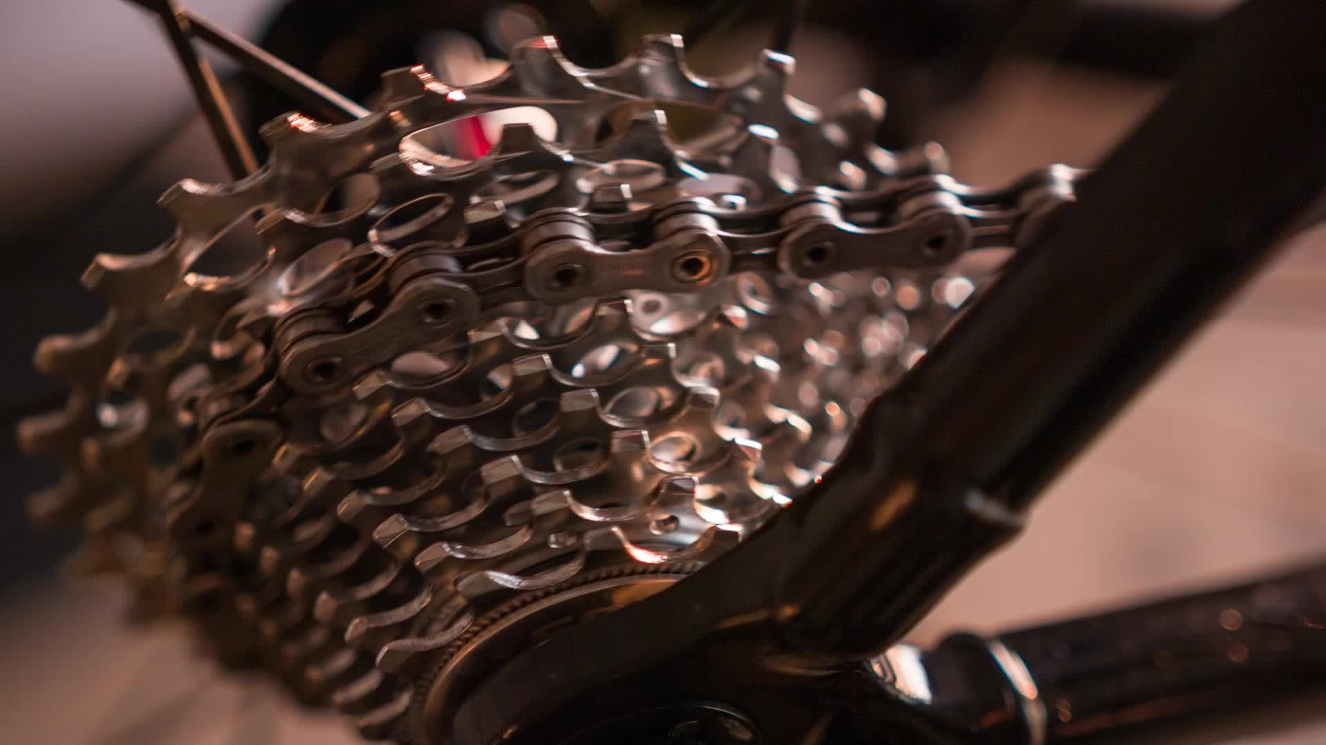

BikeStore DataBase Analysis
NTI SQL Project
linkedin.com/in/nour-khaled-b04987272/

Slide 2
- What is this Project About:
Explored a dataset containing sales, production, and customer-related data.
- Our Goal:
Extract insights and answer business-related questions using SQL.

Slide 3
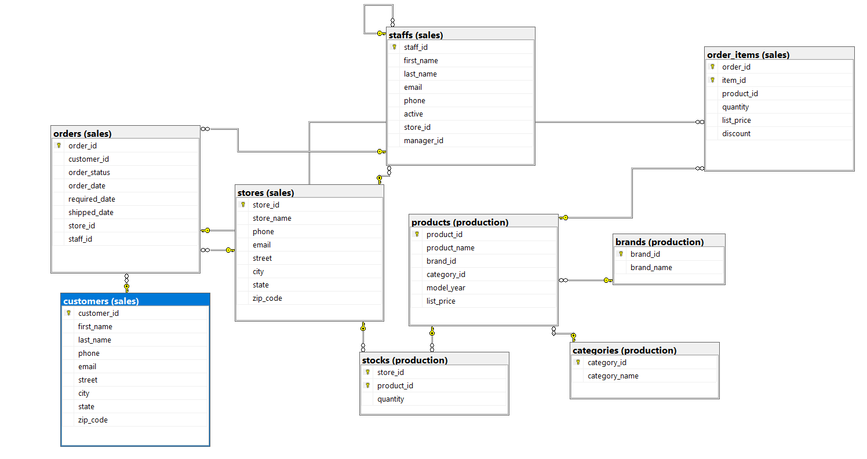
Our DB Diagram:

Slide 4
Our DB tables:
1- Customers: have the customer information like the id, name, phone, etc…
2- orders: saves our orders data like the OrderStatus, RequiredDate, ShippedDate, etc….
3- Stores: have all the information about our stores and locations we are in like StoreName, StoreID, City, State, etc….
4- Products : have all the information about the products we as ProductID, ProductName, ListPrice, etc…….
5- Staff: have all the information about the people that work with us like StaffID, Name, Email, etc…..
All of our tables in the DB are connected with each other using foreign keys like Orders and stores.

Slide 5

Analysis & Exploration Using SQL

Slide 6
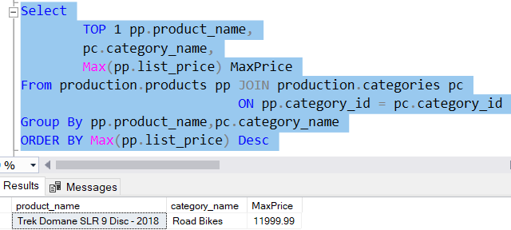
1- What is the Most Expensive Bike?
Now we can analyze more further to see a possible scenario on Why is this bike exactly is the most expensive.

Slide 7
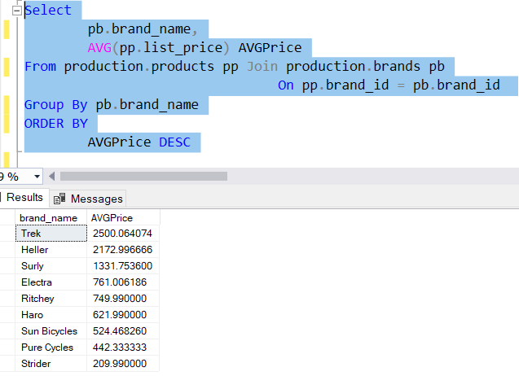
1- What is the Most Expensive Bike?
One of the reasons:
Brand Price Comparison
- we will see here that on average, the bikes of trek company are more expensive that other companies bikes.

Slide 8
1- What is the Most Expensive Bike?
Then Why it is the most expensive:
- Trek bikes are considered Pricey because of the quality, innovation, and reliability of their bikes and most people that prioritize those things Buy trek bikes, so Trek Bikes are considered a good long term investment.

Slide 9
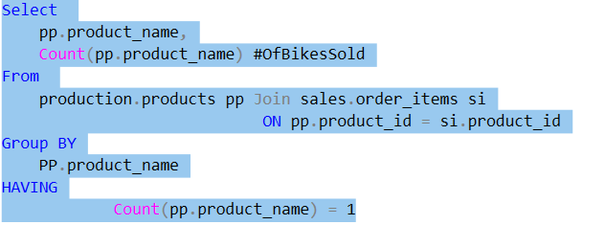
2- What is the Least Sold Bikes?
Product Name #OfBikesSold
Product Name #OfBikesSold
- We have 28 Bikes that were only sold 1 time at our store.
Electra Amsterdam Royal 8i - 2017/2018 1
Electra Cruiser 1 Tall - 2016/2018 1
Electra Cruiser 7D - 2016/2017/2018 1
Electra Soft Serve 1 (16-inch) - Girl's - 2018 1
Electra Straight 8 1 (16-inch) - Boy's - 2018 1
Electra Straight 8 1 (20-inch) - Boy's - 2018 1
Electra Superbolt 1 20" - 2018 1
Electra Superbolt 3i 20" - 2018 1
Electra Tiger Shark 3i (20-inch) - Boys' - 2018 1
Electra Treasure 3i 20" - 2018 1
Surly ECR Frameset - 2018 1
Trek CrossRip 2 - 2018 1
Trek Domane ALR 3 - 2018 1
Trek Domane SL 5 Women's - 2018 1
Trek Domane SL Frameset Women's – 2018 1
Trek Domane SLR 6 Disc - 2018 1
Trek Domane SLR Disc Frameset - 2018 1
Trek Lift+ Lowstep - 2018 1
Trek Madone 9 Frameset - 2018 1
Trek MT 201 - 2018 1
Trek Powerfly 5 - 2018 1
Trek Powerfly 5 FS - 2018 1
Trek Precaliber 16 Boy's - 2018 1
Trek Precaliber 20 6-speed Girl's - 2018 1
Trek Precaliber 24 21-speed Girl's - 2018 1
Trek Precaliber 24 7-speed Girl's - 2018 1
Trek Superfly 20 - 2018 1
Trek Superfly 24 - 2017/2018 1

Slide 10
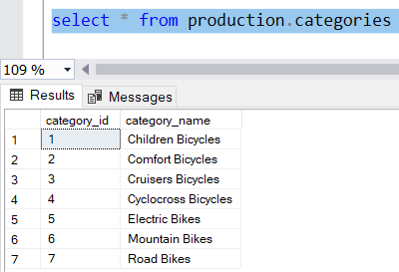
3- How Many categories we Have?
- We have 7 categories of bikes that we sell in our store

Slide 11
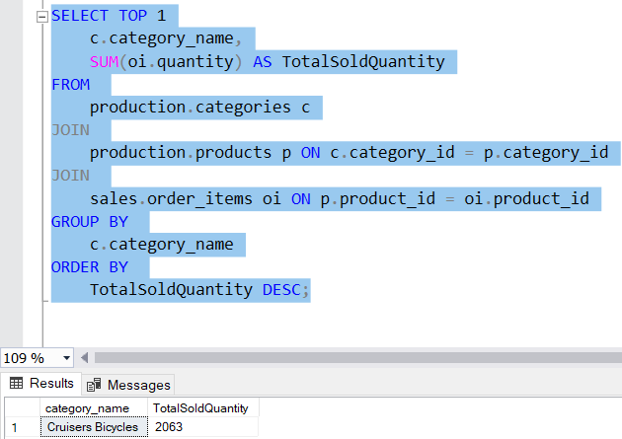
4- what is the category that sells the most bicycles?
- We will see that we sold 2063 from the Cruisers bicycles category.

Slide 12
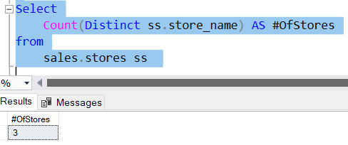
5- How many BikeStores do we have?
- We have 3 stores Baldwin bikes, santa cruz bikes, Rowlett bikes

Slide 13
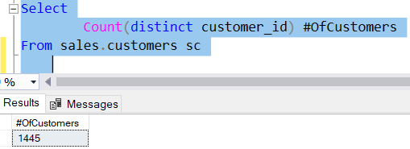
6- How many total customers does BikeStore have?
- We Have 1445 Customers in our store

Slide 14
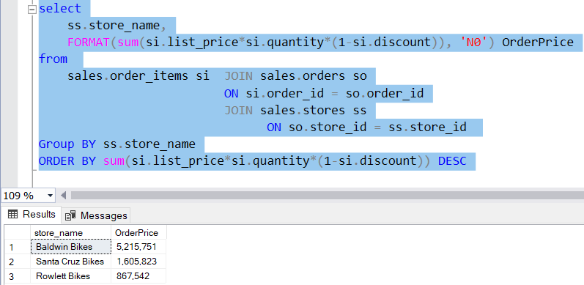
7- what is the total revenue per store?
- We will see that Baldwin Bikes store is the store with the highest revenue among our stores.

Slide 15
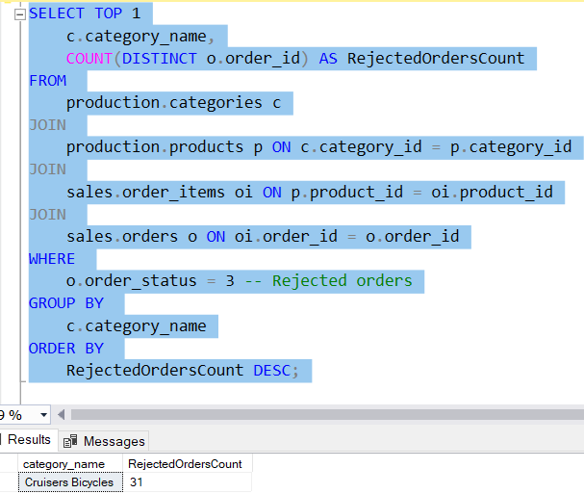
8- which category rejected more orders?
- We will see that we Cruises bicycles rejected around 31 orders.

Slide 16
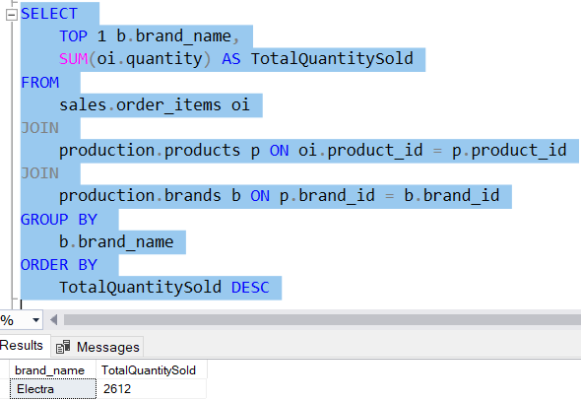
9- Which brand is the most liked?
- Here we measured how likeable the brand is by the total quantity of bikes sold for this brand, and we will find here that ELECTRA is the most likeable brand.

Slide 17
Important Question Coming !!!!!!!!!!!!!!!!!!!!!

Slide 18
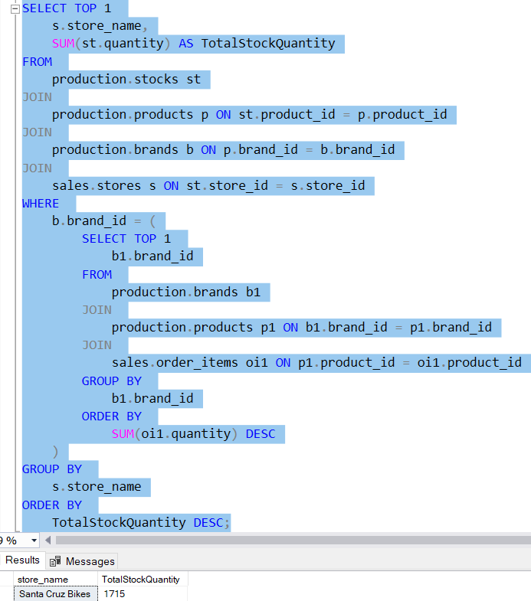
10- Which store still have more products of the most liked brand?
1st Method:
We can Also answer this question by another way as follows

Slide 19
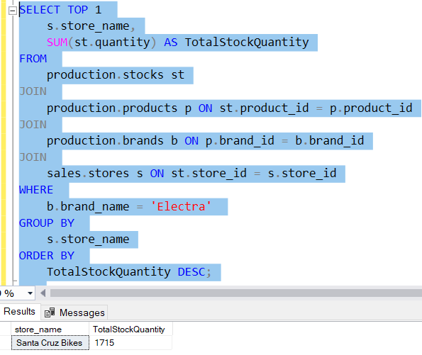
10- Which store still have more products of the most liked brand?
2nd Method:
Now let’s see what is better between those two methods to answer this question and why

Slide 20
Comparison between the subquerie we made and the direct querie to answer question 10:
Points of comparison | Method 1: Subquery with brand_id | Method 2: Direct Condition with brand_name
Logic | Dynamically determines the top brand by total quantity sold using a subquery. | Hardcodes the brand name 'Electra' directly in the WHERE clause.
Flexbility | Flexible: Automatically adjusts to the top-performing brand. | Static: Limited to 'Electra'; needs manual adjustment for other brands.
Readability | More complex due to the nested subquery logic. | Simpler and easier to read as it directly specifies the condition.
Performance | Slightly slower due to the subquery that calculates the top brand dynamically. | Faster since it avoids the overhead of a subquery and works on a fixed condition.
Maintenance | Easier to maintain when brands change dynamically. | Requires manual changes if the target brand changes.
Use Case | Suitable for scenarios where the top-performing brand is unknown. | Suitable when the specific brand name is known in advance.

Slide 21
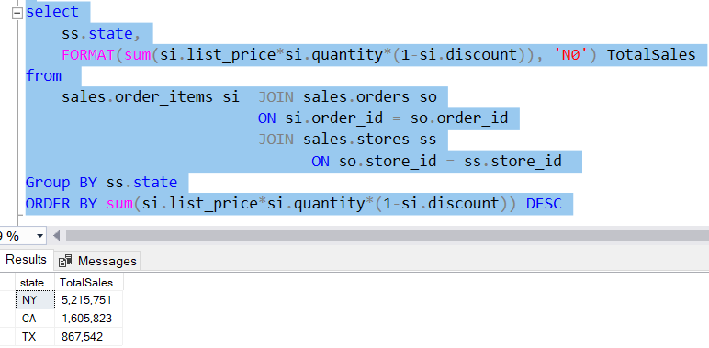
11-Which state is doing better in terms of sales?
- We will see that new York is the city with the most sales

Slide 22
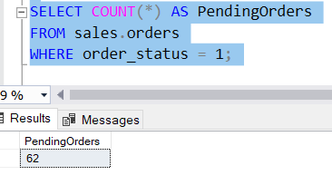
12-How many orders are still pending?
- We Have 62 pending orders.

Slide 23
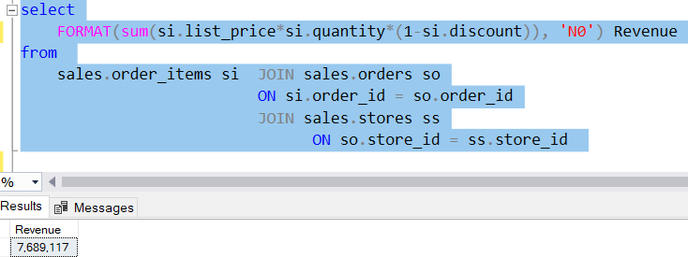
13-Total Revenue
- We $7, 689,117 of total revenue.

Slide 24
Insights from the Analysis:
Most sold product: TREK DOMANE SLR 9 Disc - 2018
Total Customers: we have 1445 Total Customers
Highest store in revenue: Baldwin Bikes with $5,215,751
Most likeable brand: ELECTRA
Total Revenue: $7, 689,117

Slide 25
Recommendations
1- We have to take care of the least sold bikes and see why they aren’t sold because if people don’t like them at all then we shouldn’t buy them at the first place.
2- we should stay also focused on our most sold bike and see if this is just a trend or a seasonal thing or we should just keep buying this bike and provide plenty of it in stock.
3- we should see why there is quite a gap between baldwin bikes and the other stores.

